Slide 1
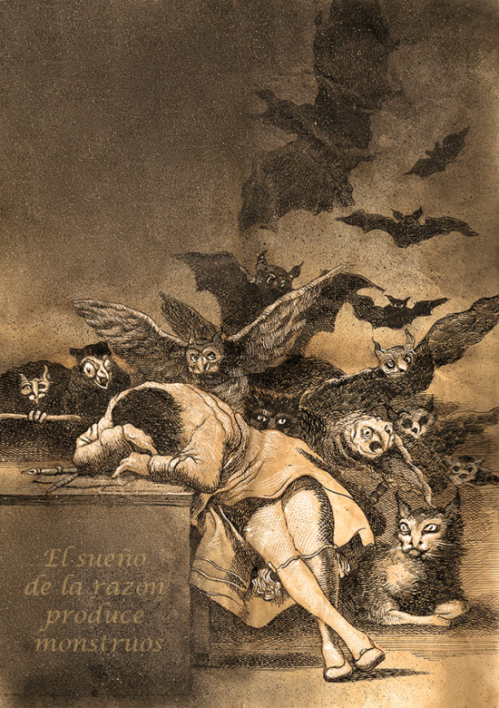
Liberal Tradition II

Slide 2
The Enlightenment gave us reason and rationality. What did the best of the Enlightenment have to do with the worst of the Enlightenment.
Immanuel Kant

Slide 3
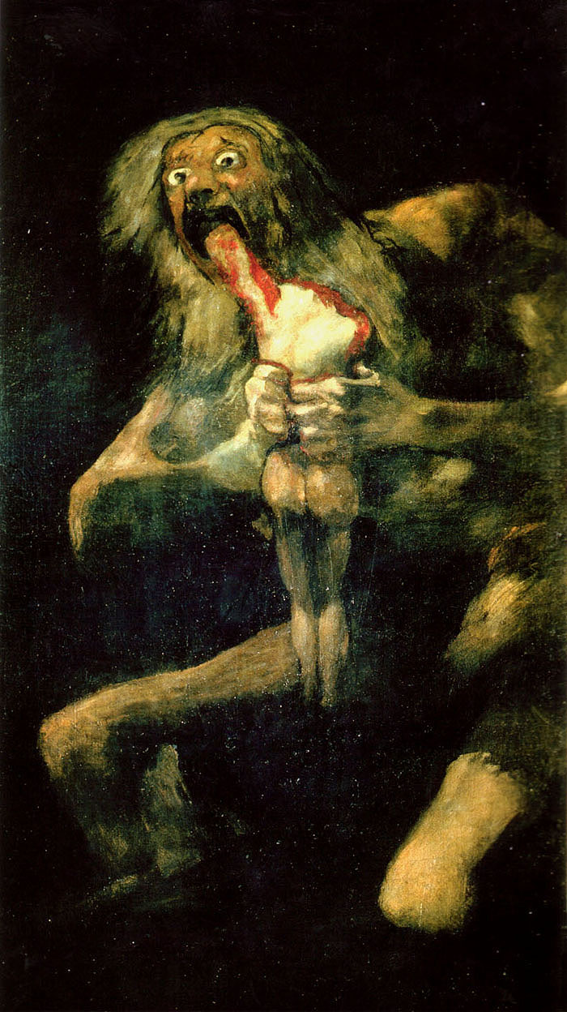
Romanticism draws us to the dark side (anxiety, horror, irrationality). Romanticism offered an alternative to enlightenment and reason.

Slide 4
Elizabeth focused on the restoration of the old order and yet people were still pouring into unban centers. Death, disease and pestilence were never far away.
What was the importance of Utilitarianism?
Its strengths
Its weaknesses
Mill writes both Utilitarianism and On Liberty. Is there a tension between these two texts? Notice doing the greatest good for the greatest number can be used to deny liberty.

